Slide 1
FOUNDER’ S AT WORK
PRESENTED BY TEAM SQUARES
MEMBERS: JAWERIA ASIF(9442)
JAVERIA HASSAN(9517)
RAHEEL DASTAGIR(9334)

Slide 2
FOUNDER’ S AT WORK
INTRODUCTION OF AUTHOR:
Jessica Livingston (born February 5, 1972) is an American author and a founding partner of the seed stage venture firm Y Combinator. She also organizes Startup School. Previously, she was the VP of marketing at Adams Harkness Financial Group. She has a B.A. in English from Bucknell University. In early 2007, Livingston released “Founders at Work: Stories of Startups' Early Days” (published by Apress), a collection of interviews with famous startup founders

Slide 3

FOUNDER’S AT WORK
KEY IDEA #01:
Many big startups ended up with an idea or product very different than the one they started out with.
Take Example of PayPal and blogger.com

Slide 4

FOUNDER’S AT WORK
KEY IDEA #02:
Sometimes innovative ideas can seem confusing or too tricky to understand for people, which is problematic if your idea needs funding to develop.
Take Example of WebTV

Slide 5
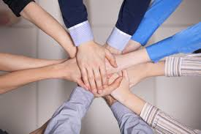
FOUNDER’S AT WORK
KEY IDEA #03:
Having a good team is more important then a good idea.
Take Example of Exite

Slide 6

FOUNDER’S AT WORK
KEY IDEA #05:
many startups began as solutions to personal problems, until the founders realized that millions of other people could also beneﬁt from their idea.
Take Example of Hotmail

Slide 7

FOUNDER’S AT WORK
KEY IDEA #06:
Sometimes, simpler is better.
Take Example of 37 Signals

Slide 8

FOUNDER’S AT WORK
KEY IDEA #07:
Too much investor money can hurt a startup, so ﬁnd other ways to generate revenue or stay cheap.
Take Example of Ars Digita

Slide 9

FOUNDER’S AT WORK
KEY IDEA #08:
It’s better to learn from other’s mistake and avoid those mistakes in your startups.
Take Example of Fog Creek

Slide 10

FOUNDER’S AT WORK
KEY IDEA #09:
It’s best to be honest while making something people really need.
Take Example of Viaweb and Y-Combinator

Slide 11
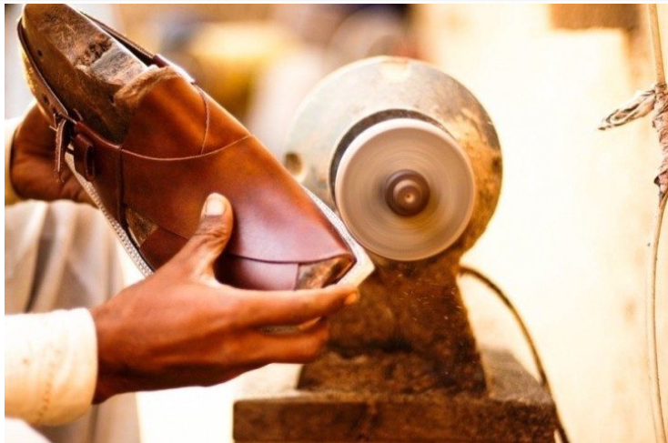
FOUNDER’ S AT WORK
RECOMMENDATIONS AND ANALYSIS:
MARKHOR:
Markhor is an e-commerce platform which sells footwear and accessories inspired by simplicity and craftsmanship.
Markhor was the first startup of Pakistan which appeal for fund raising to Y-combinators.
Founded by Sidra Qasim and Waqas Ali.

Slide 12

FOUNDER’ S AT WORK
RECOMMENDATIONS AND ANALYSIS:
Startup’s, fundraising and Growth After 2012:
Startup Name | Zameen.com | Slide | Well | Finja | Beauty Hooked
Service | Property portal | Lock screen app | Retailer of medicines | Online transactions | Spa or saloon
Fund Raising | 20 million $ | 3.6 million $ | 1 million $ | 1 million $ | 2,80,000
Rank in Pakistan | 118 | Not available | 4,714 | 19,760 | 35,507

Slide 13


FOUNDER’ S AT WORK
RECOMMENDATIONS AND ANALYSIS:
RECENT STARTUP’S IN PAKISTAN:
EASYPAISA:
It is a mobile wallet solution for offline and bill payments.

Slide 14


FOUNDER’ S AT WORK
RECOMMENDATIONS AND ANALYSIS:
RECENT STARTUP’S IN PAKISTAN:
AUTOSAHULAT:
AutoSahulat is an online platform that connects drivers with automotive service providers.

Slide 15


FOUNDER’ S AT WORK
RECOMMENDATIONS AND ANALYSIS:
RECENT STARTUP’S IN PAKISTAN:
MARHAM:
Marham offers appointment booking, a Q&A forum and a health blog for consumers to make better-informed health decisions.

Slide 16


FOUNDER’ S AT WORK
RECOMMENDATIONS AND ANALYSIS:
RECENT STARTUP’S IN PAKISTAN:
MARHAM:
Nearpeer is an online courses platform which provides university courses and professional certification prep.

Slide 17
FOUNDER’ S AT WORK
RECOMMENDATIONS AND ANALYSIS:
ARE THESE IDEA’S ARE APPLICABLE IN PAKISTAN?
1- For young entrepreneurs who want to start their business, Yes these all idea's are applicable in Pakistan for growth and development a startup
2- It is better to understand from the mistakes of others and try to avoid those mistakes in your own startup
3-This book is not only telling success stories of founders but it also tell us why start up’s fails

